Slide 1
Analyzing the factors influencing housing prices in India
The main objective of this research initiative is to explore the various factors that influence housing decisions in India

Slide 2

TEAM MEMBERS
1.Keerthi Jayaram
2.Shashank Mysore
3.Saurab Khatri
4. Pratik Mane
5.Yash Jivani

Slide 3
Table of Contents
01
02
03
04
Exploratory Analysis & Processing
Model Processing
Result
Thank you

Slide 4
Exploratory Analysis
Analysis of Graphs obtained

Slide 5
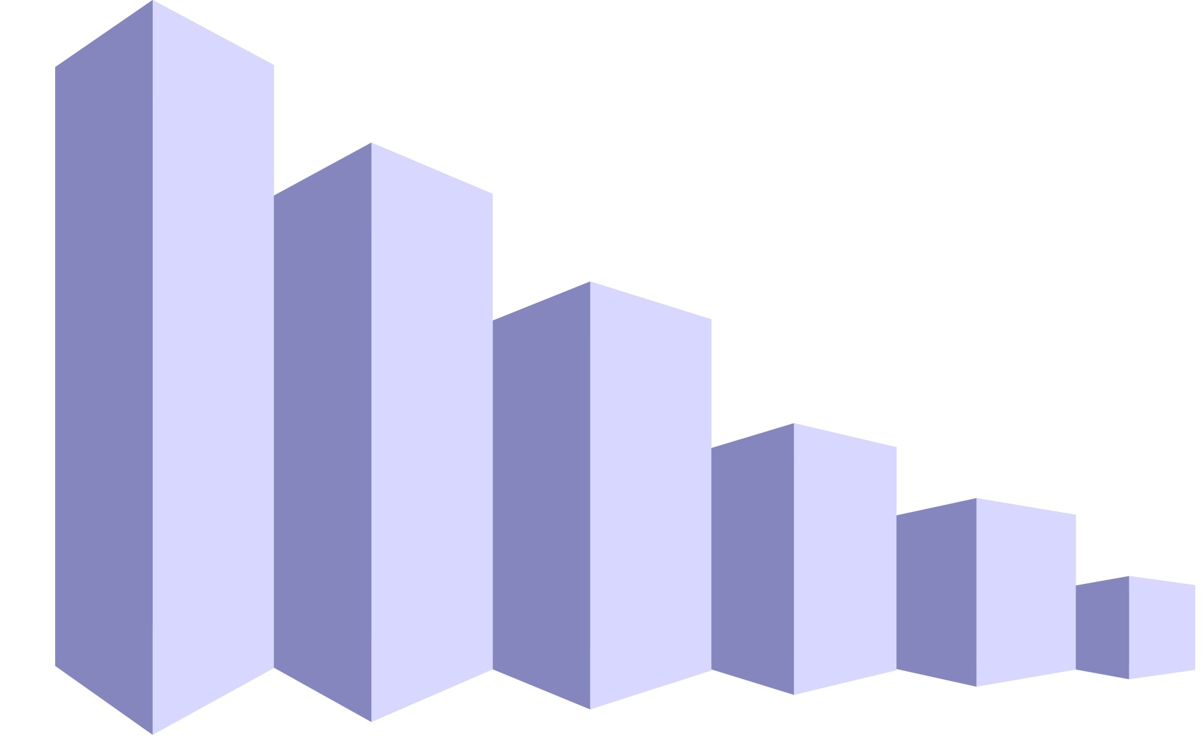
Data set and Preview
Data
What is the source?
The dataset is sourced from Kaggle.
What are your variables?
Dependent Variable (DV) / Explained Variable: Price
Independent Variable (IV) /Explaining Variable: Type, Transaction, Status, Parking, Locality, Furnishing, Bathroom, BHK & Area
Provide descriptive statistics:
Stats for - Output column – Price: Mean = 21M, Median = 14M
Based on the stats values, there are a couple of houses which are costly and have more than 100M price. There are 19 such houses and among those, most are ready to move status and new property.
Price value has a couple of outliers which may be removed to improve model results. Mean value is more than the median because of high prices houses, so we can consider median price.
And surprisingly, houses have no. Of bedrooms = 10 is not present in the above results, so it doesn’t affect more on the price.
Next going with the Area of houses, mean value is 1500, but max of 24K. Based on the box plot distribution - couple of values have too high area

Slide 6
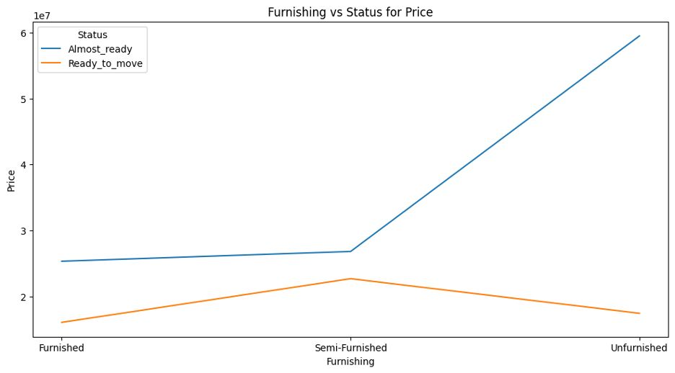
Understanding the Problem
1. How Does Furnishing vs Status of the house affects the Price of the house
The houses which are Almost Ready but unfurnished has the highest price as compared to the houses which are ready to move but are not furnished similar trends are seen for Semi Furnished and Furnished houses
For Almost ready houses Unfurnished houses has highest average prices followed by semi-furnished and then furnished.

Slide 7
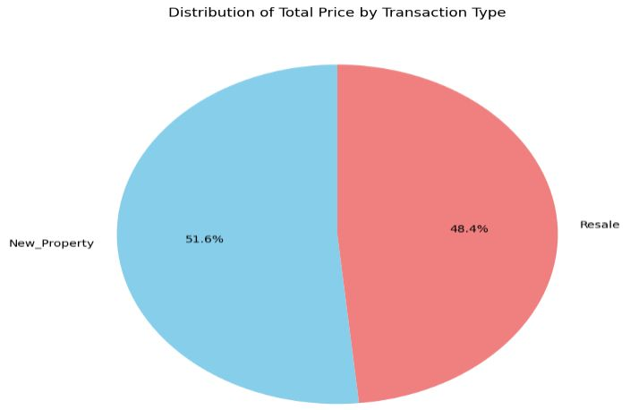
2. What is the Distibution of the total price by transaction type?
To find this we have plotted a Pie chart, transaction is divided into two categories New Property and Resale, our aim here to find which one of them has more average price
The Pie chart makes it clearer that the new houses have a higher average price than the resale houses.

Slide 8
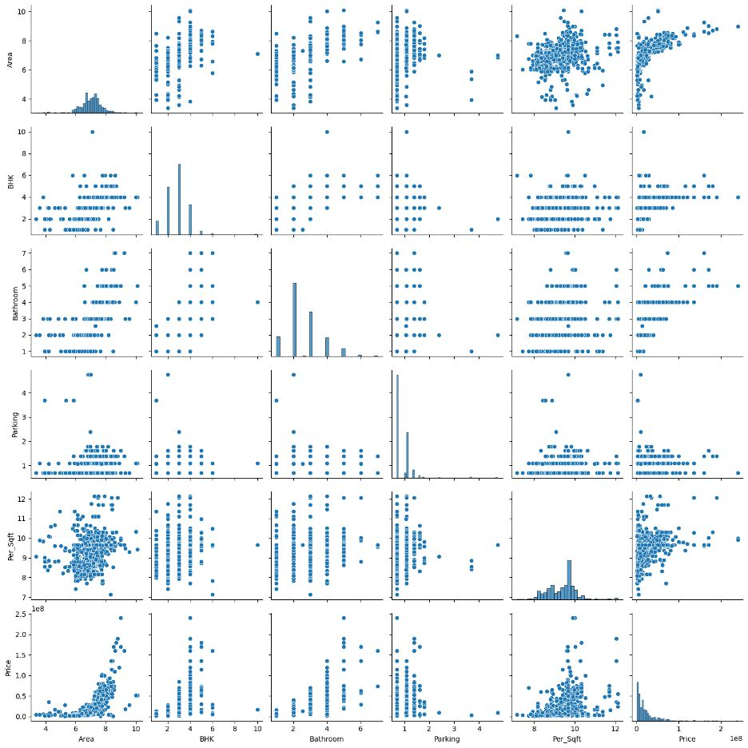
3. Does the number of rooms affect the price of a house?
The pairplot displays the relationship between six variables: area, BHK, bathroom, parking, price per square foot, and total price
Looking at the graph, the BHK and Prices have a strong positive correlation. Along with BHK, Area, Bathroom, parking and per square foot also have strong positive correlation with prices

Slide 9
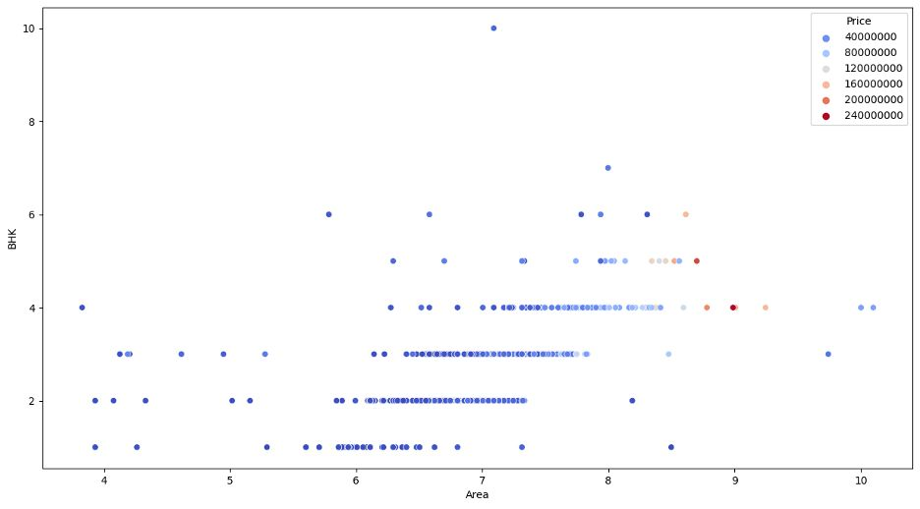
4. Does the BHK per area really affect the price of the apartment, od prices for BHK are standard and are not related to the area of BHK?
As shown below in the Heatmap, we can see BHK Ratio which states a good correlation with the Price of the house, the correlation ins (0.41)
The following plot shows the price of house increases for BHK as the area of BHK increases, that is the bigger BHK house the more expensive it is. Also, we can see some outliers in the graph.

Slide 10
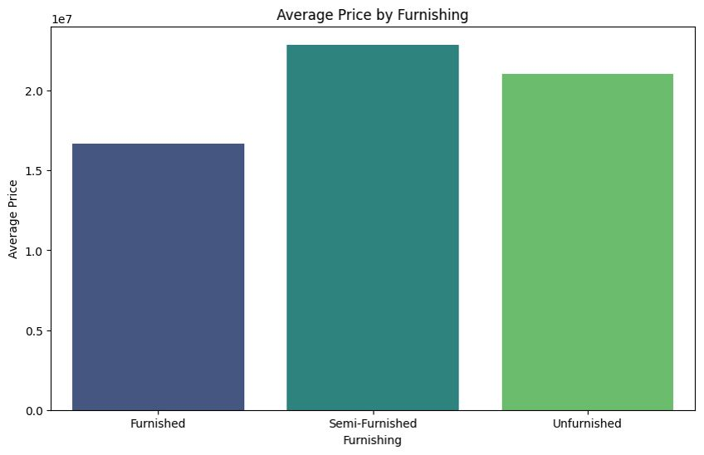
5. How does the Furnishing variable in the dataset is related to the Price of the house
Almost ready houses have a strong relation with the Price of the house. The Following bar chart shows the average price of house per Furnishing.
The graph shows average Price of semi-furnished is highest followed by unfurnished and furnished, the reason for this is the number of records present in the dataset for unfurnished

Slide 11
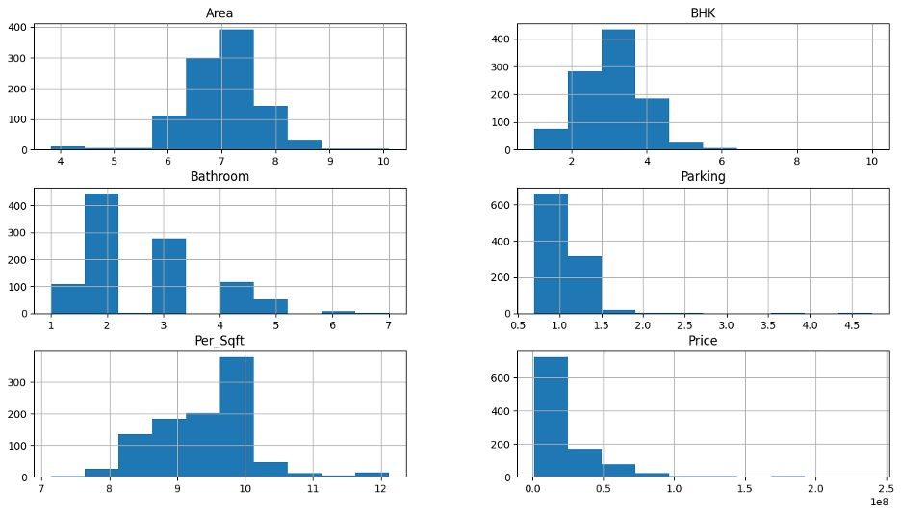
6. Are there any outliers in the dataset and what is the spread of the data?
According to the boxplot shown below it explains that the spread of data in Area, BHK, Per_Sqft and bathroom is good, although we can see some outliers in all

Slide 12
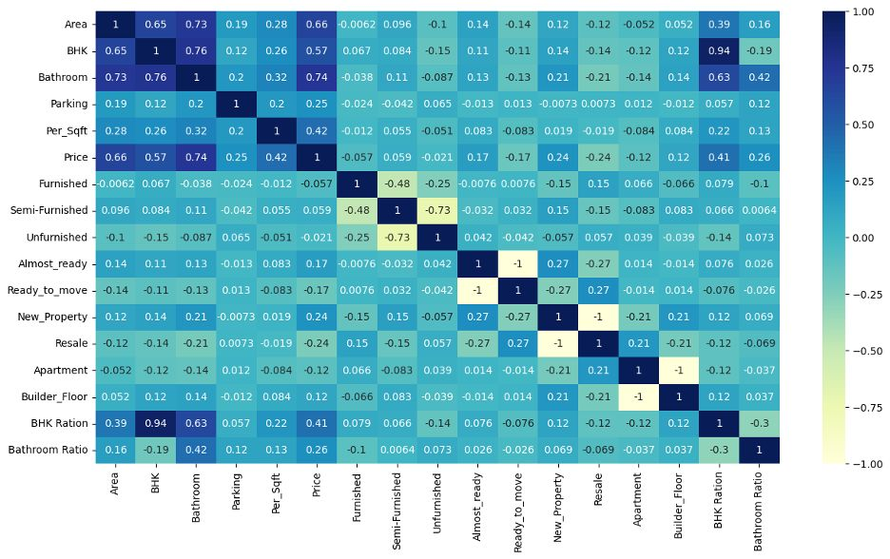
Heat Map to find Co-relations
While doing the analysis and trying to find the correlation, we got to know that Bathroom is more closely related to price than any other variable, so understand that we performed feature engineering on bathroom variable,
we divided bathroom variable with number of bedrooms to find if the correlation of bathroom per bedroom is related to price or not as shown in the heat map we can see bathroom ratio is related to Price variable

Slide 13
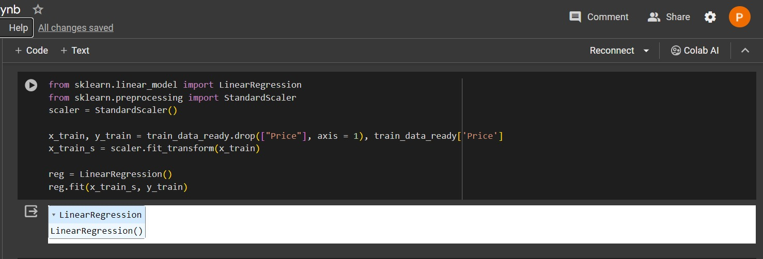
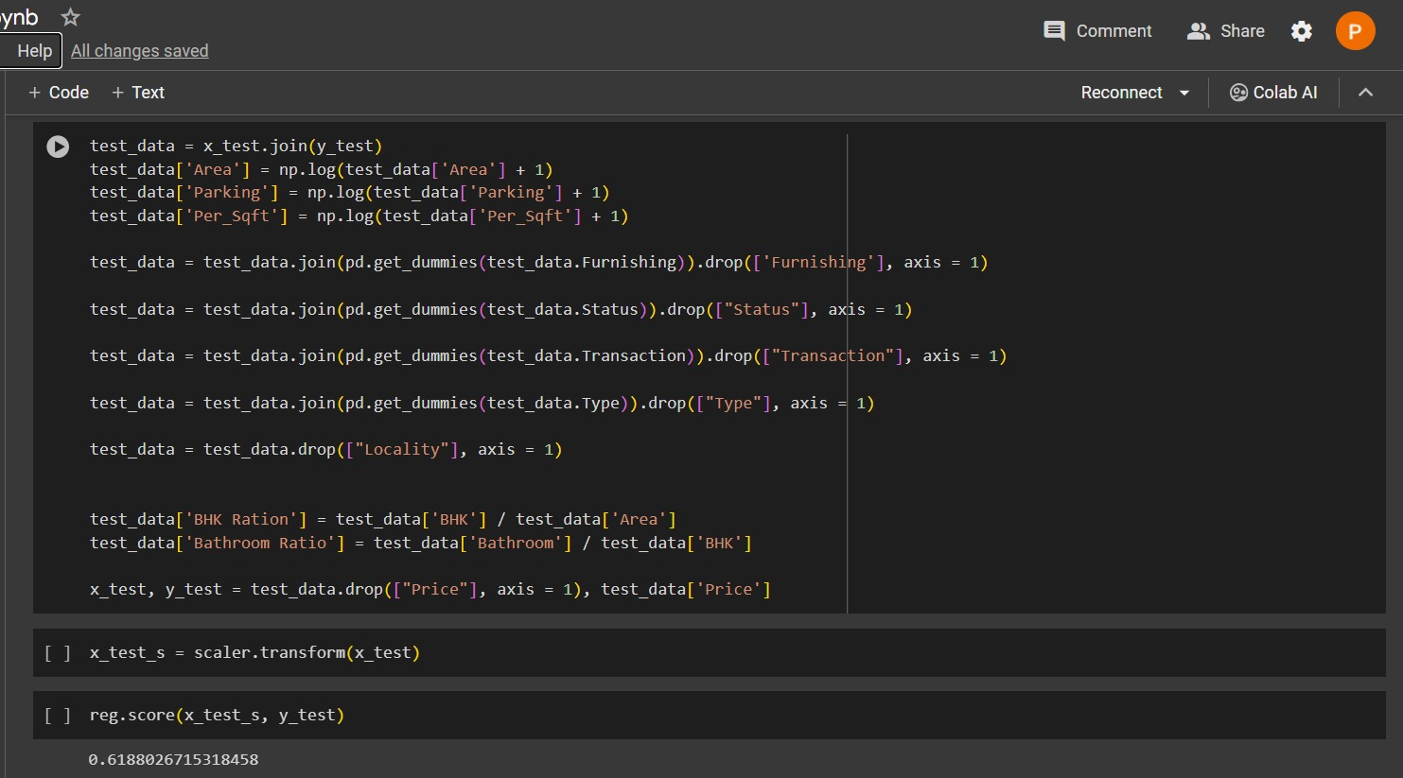
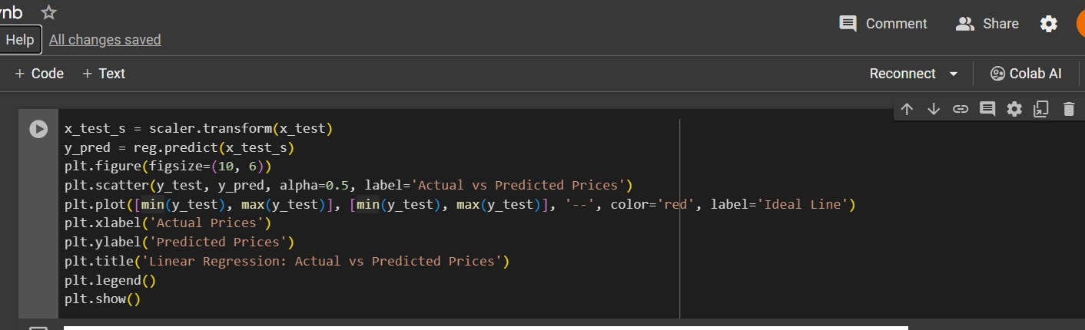
PROCESSING

Slide 14
Model processing

Slide 15
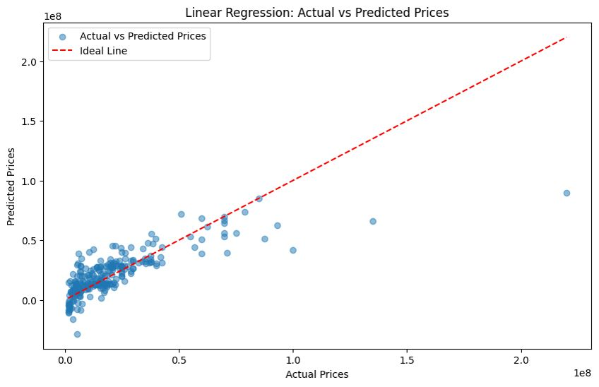
Linear Regression

Slide 16
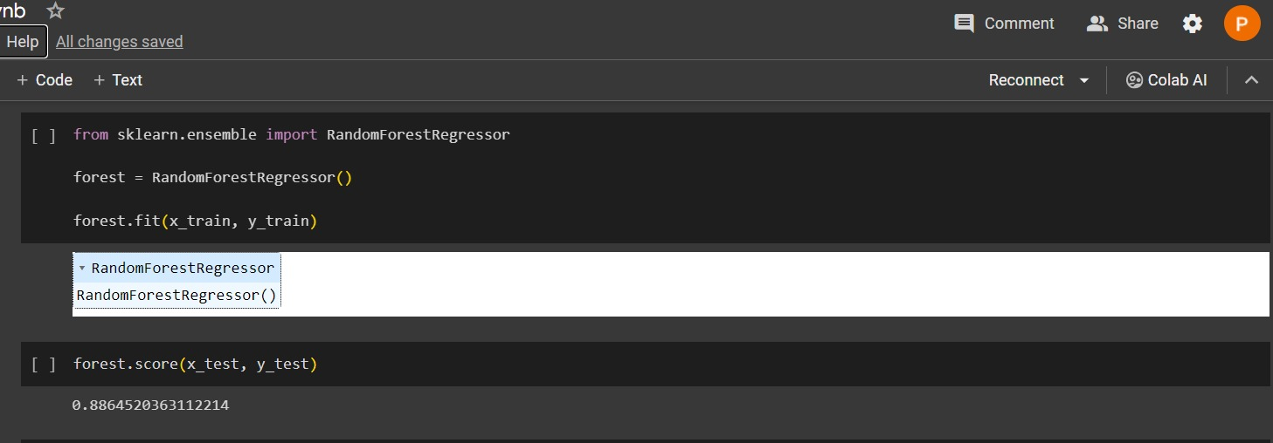
Random Forest Regressor

Slide 17

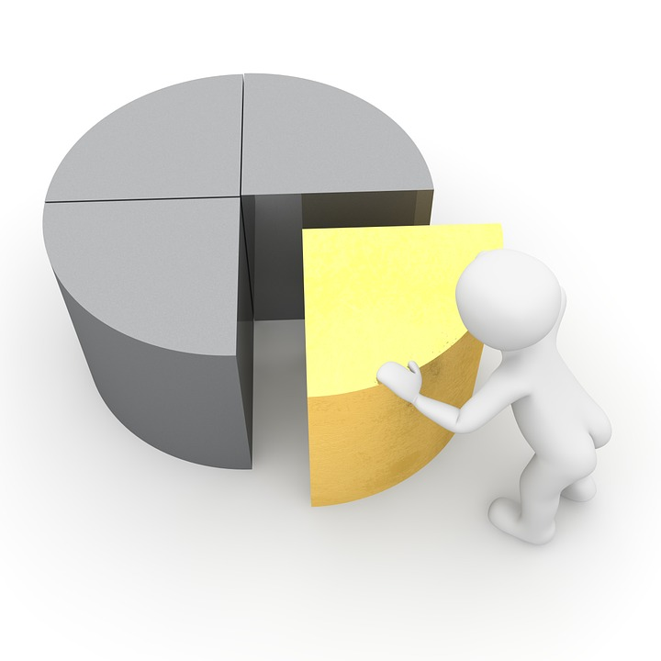
RESULTS
We tried the same with random forest regressors and obtained the accuracy of 88.65. Having accuracy between 60-70 for machine learning model is not great, as demonstrated in the above slide for the linear regression model for our datset, for which we obtained 61% accuracy.We also discovered that prices are highly correlated with area, BHK, bathroom, and square feet.

Slide 18


